Slide 1

Crimes in Chicago.
Supervisor/
Dr/ Doaa Mahmoud Abdel-aty

Slide 2
EVIDENCE · EVIDENCE · EVIDENCE · EVIDENCE
EVIDENCE · EVIDENCE · EVIDENCE · EVIDENCE
Mohamed Adel Hosny
https://www.linkedin.com/in/mohamed-adel-hosny-692283a3
Kamar Seddeik Shahein
https://www.linkedin.com/in/kamar-shahein-1314461b7
DO NOT CUT HERE TO OPEN DO NOT CUT HERE TO OPEN
DO NOT CUT HERE TO OPEN DO NOT CUT HERE TO OPEN
DO NOT CUT HERE TO OPEN DO NOT CUT HERE TO OPEN
DO NOT CUT HERE TO OPEN DO NOT CUT HERE TO OPEN
Kaggle Data reference/
Crimes in Chicago
https://www.kaggle.com/datasets/currie32/crimes-in-chicago

Slide 3

Agenda !
2-Business idea and Target of Data
1-Introduction of Crimes In Chicago Data
3-Data problems and cleaning
4-Data Exploration
6-Appling Models
And Model Comparison
5-Data Decoding and feature selection
7-Conclusion and recommendations

Slide 4
1- Introduction
Data is about 7 Million records.
Some of features are { ID , District , Arrested , Primary Type , Description , Domestic , Latitude , Longitude , FBI code , Updated On , Community Area , ….etc }
1
4
3
2

Slide 5
2-Business idea and Target of Data
Controlling the recourses.
Improving the performance of Police department in Chicago.
Study the effect of economic on crimes
Classification : “Arrested” to get a standard
1
References:
The impact of the 2008 economic crisis on imprisonment in Europe
By: Jorge Rodríguez-Menés
(https://journals.sagepub.com/doi/full/10.1177/1477370819830586)

Slide 6
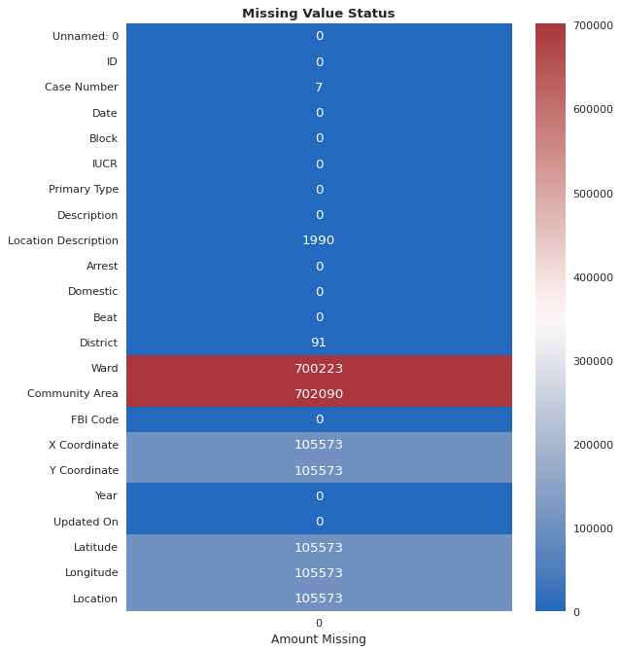
3-Data problems and cleaning
Duplicates
Missing?
Dropping features
Logical!
1

Slide 7
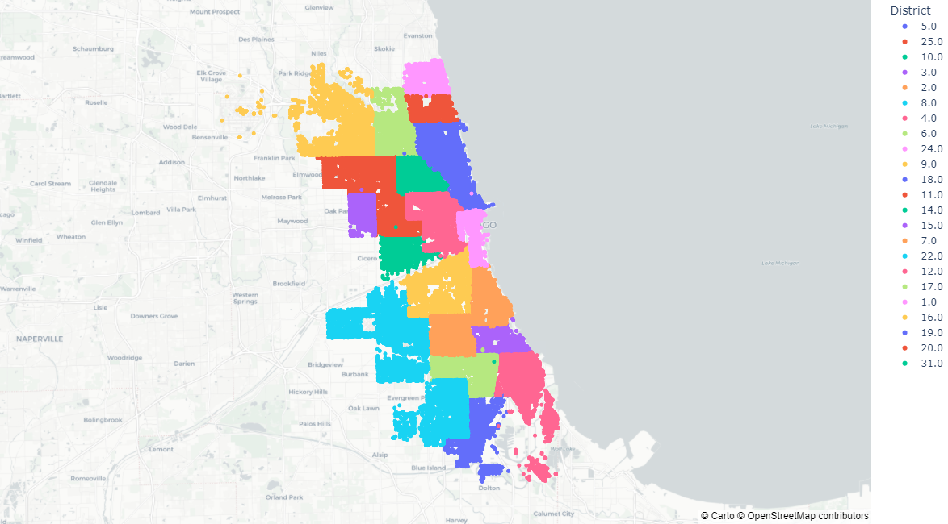
A sample of 100,000 records

Slide 8

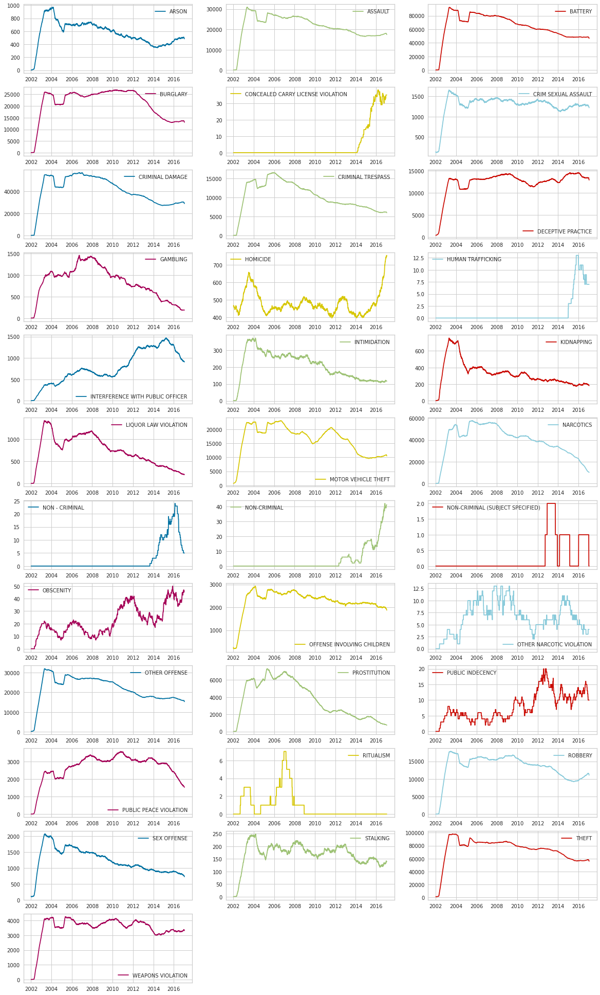
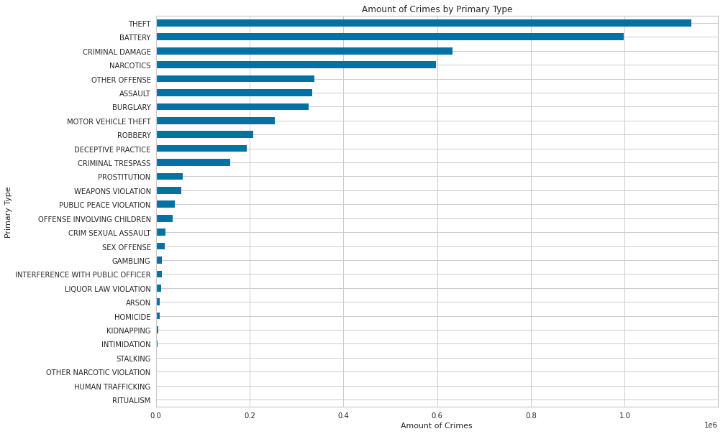
4-Data Exploration
Theft
Battery
Criminal Damage
Classifying the crimes according its “Type”
You can move the lines to connect the notes you want.
Who?
When?
Why?
I know!
8

Slide 9
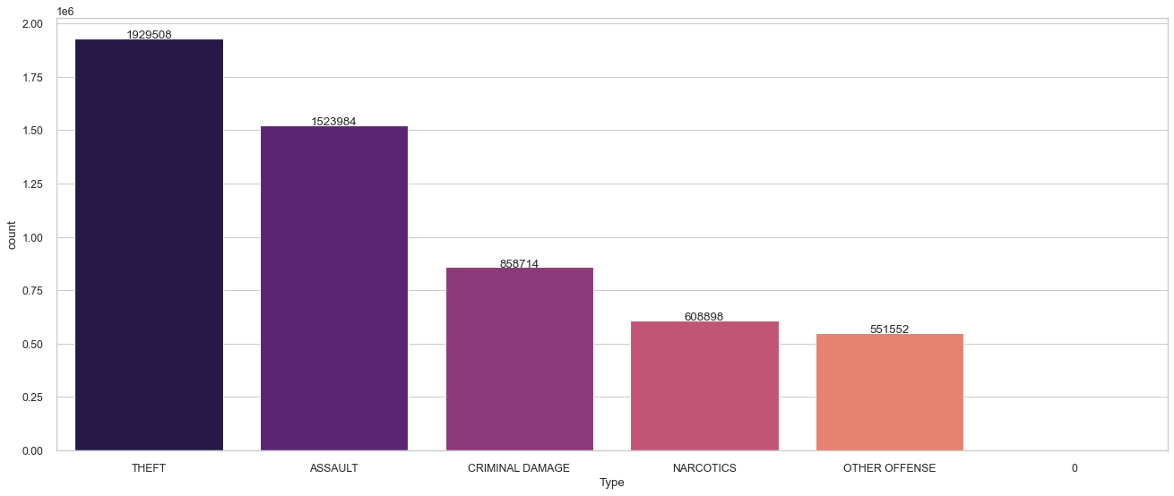
We have calculated the number of crimes for the most types and dropped the “non-criminal types “ from the results.

Slide 10
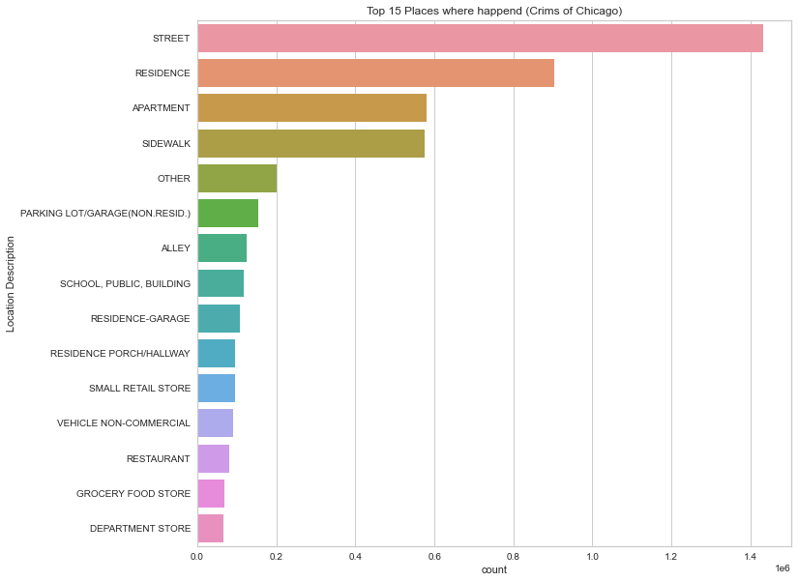
4-Data Exploration
3
2
4
Places :
Street
Residence
Apartement
7
6
8

Slide 11
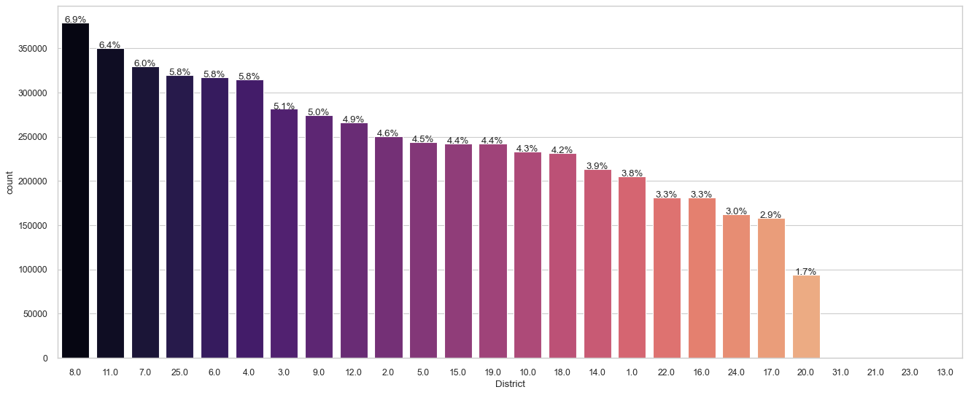
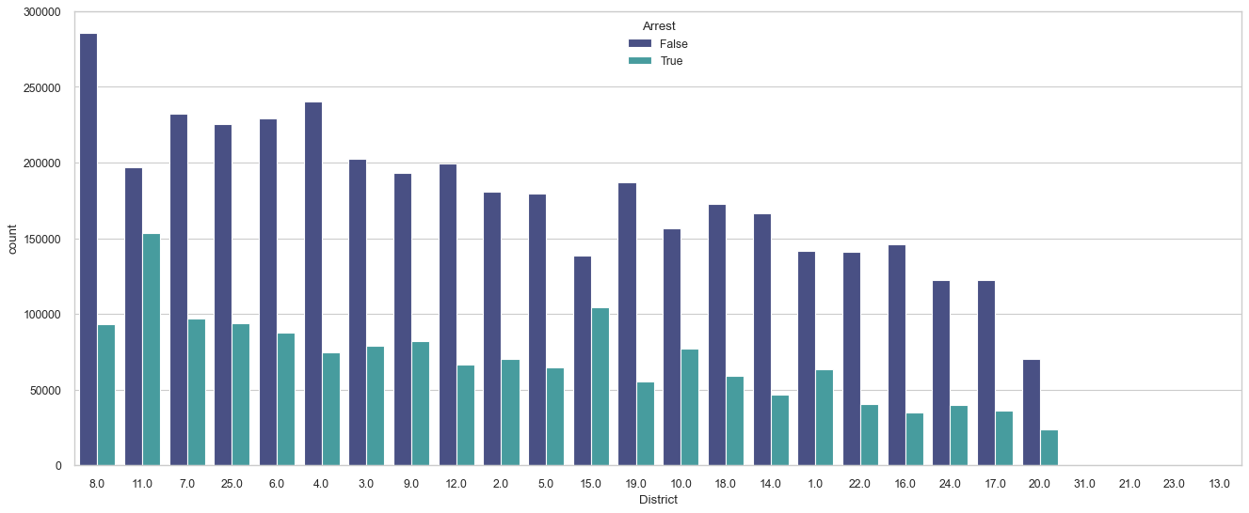
4-Data Exploration
The Most District according to crimes is “ District 8”
However the crimes in D (11) is high,
The efficiency of police department is high in arresting criminals.
11

Slide 12
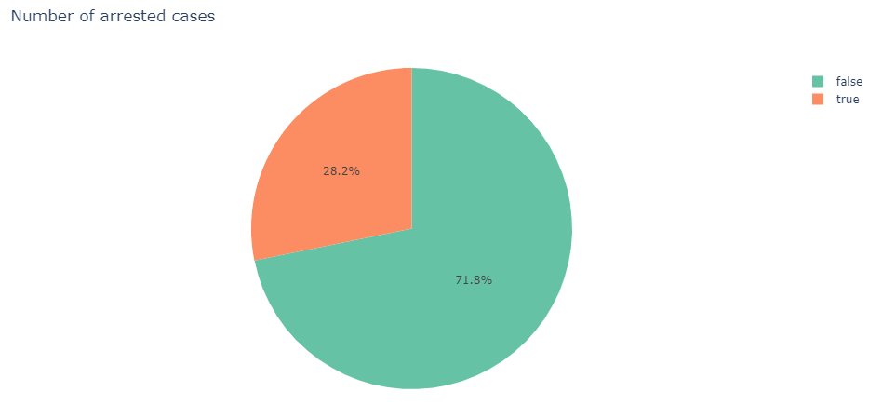
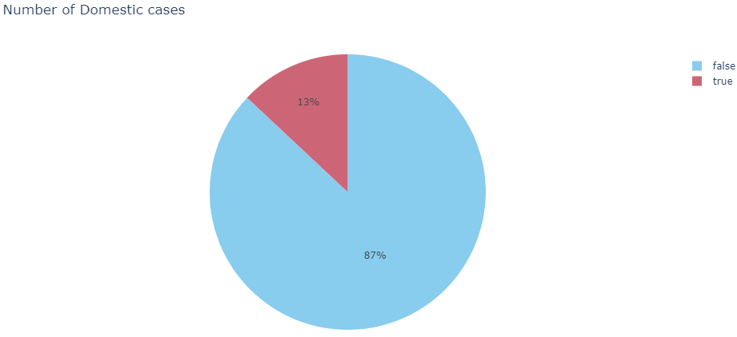
The Percentage of Arrested and Domestic Crimes: Arrested = 28% Domestic = 13%
4-Data Exploration

Slide 13
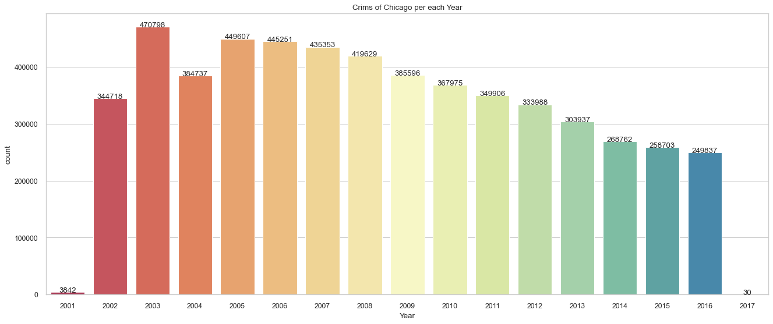
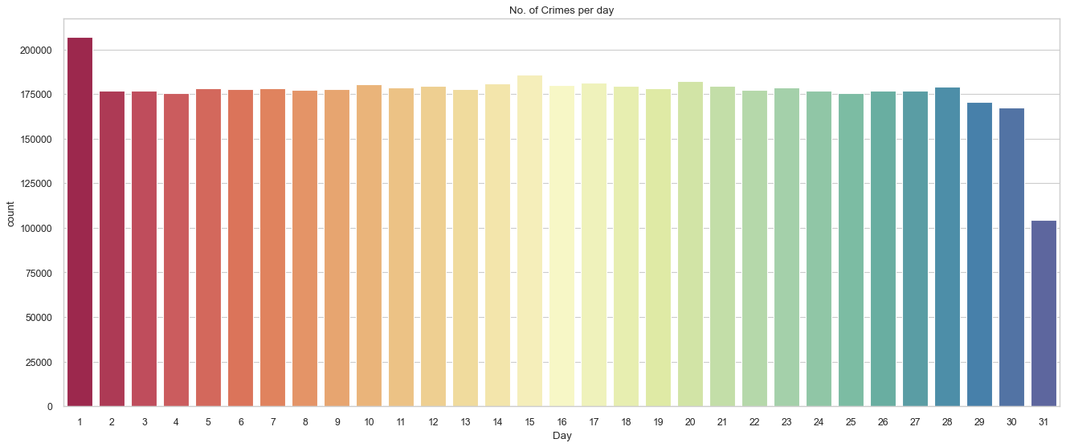
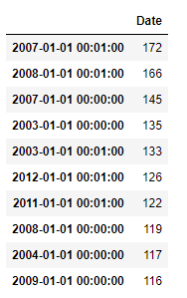
The most year with crimes is 2003, however the sudden drop in year 2004, the crimes is about to decrease with time.
The most crimes happen in the first day in the month.
The most seasonal time with crimes is the New Year Eve.

Slide 14
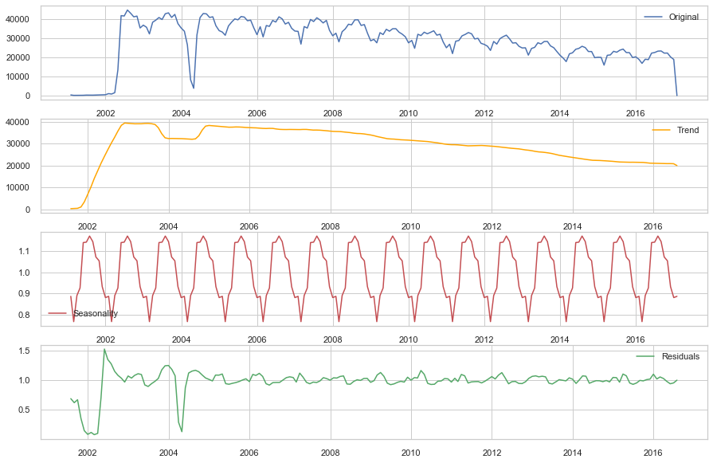
4-Data Exploration
3
2
4
The trend of data is about to decrease with time.
The amount of residuals is approximate same except in years 2004 and 2002.
7
6
8

Slide 15
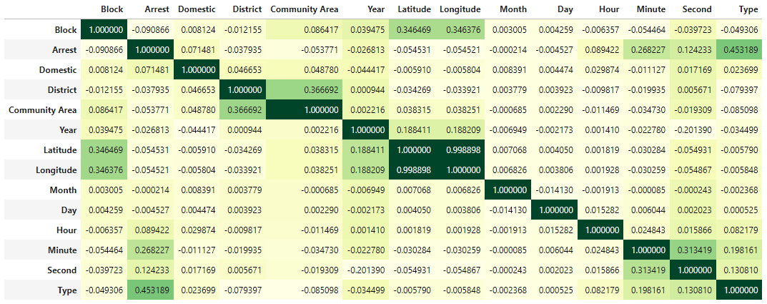
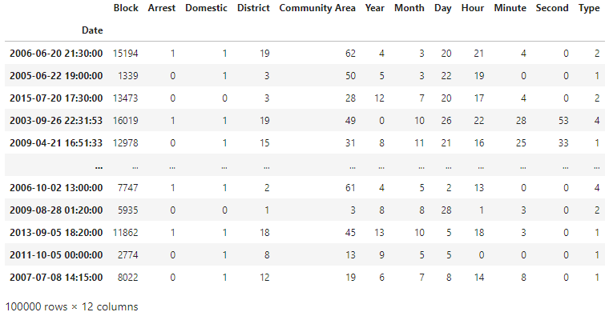
5-Data Decoding and feature selection
The highest correlation “Arrest “with “Type “
15

Slide 16
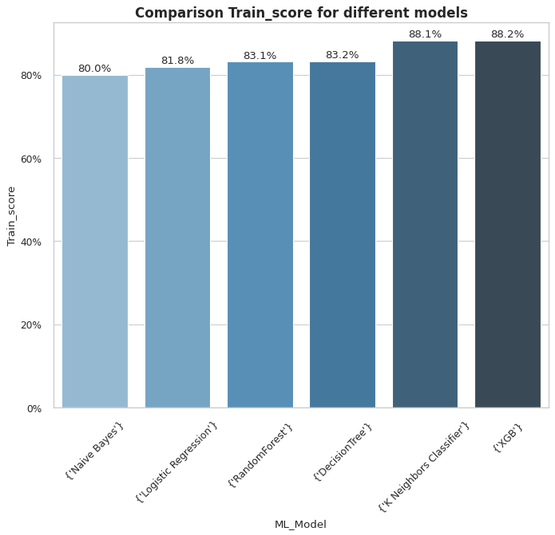
6-Appling Models And Model Comparison
Naive Bayes
XGB
Random Forest
Decision Tree
K Neighbors Classifier
Logistic Regression
1

Slide 17
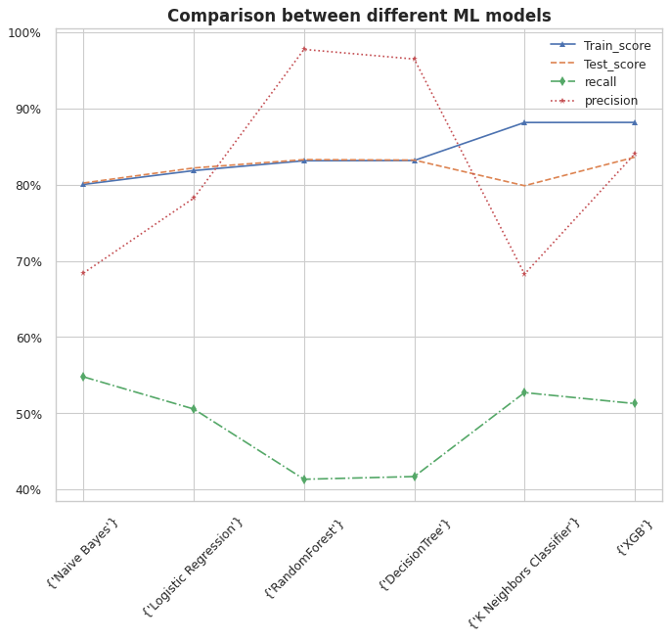
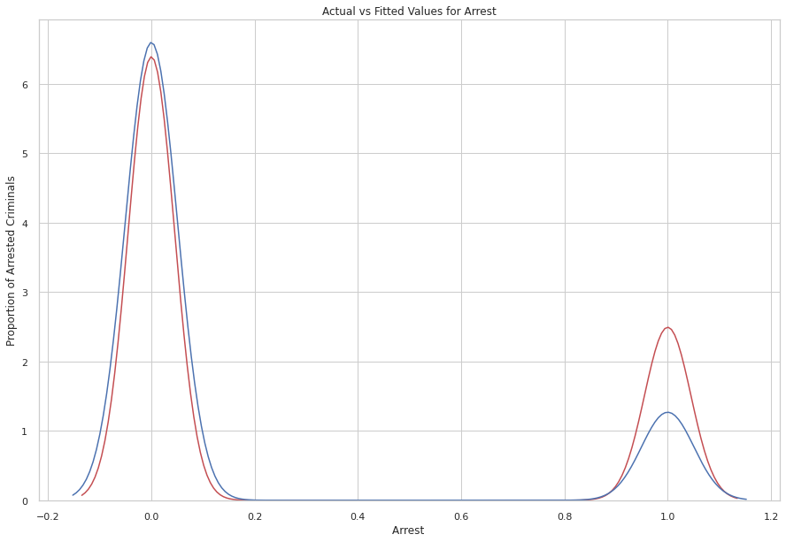
The train scores and test scores for all models are almost the same.
The precision is high in Random Forest and Decision Tree models.

Slide 18
7-Conclusion and recommendations
Protocols used in District 11 need to studded and applied on the other Districts.
The curve of time with criminals is decreasing.
In New Years Eve, the police department must be in full potion as it is the highest number of crimes commit that day.
For measuring the department performance , we can use Random forest or Decision Tree models to predict the number of arrests that may happen and evaluate the recourses.
18

Slide 19
Case Closed.
Thank You
19

